Slide 1
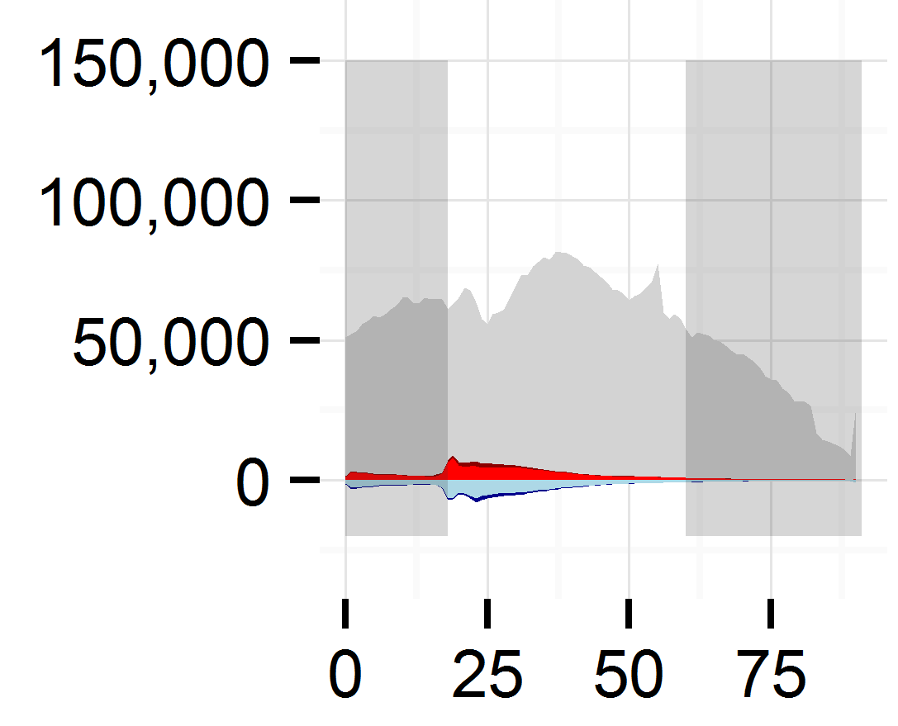
Childhood
Dependency
Retirement
Dependency
Key
Working Age
Overall Population Structure
International In-migration
Internal In-migration
Population Count
International Out-migration
Internal Out-migration
Age in Years

